Slide 1



Slide 2
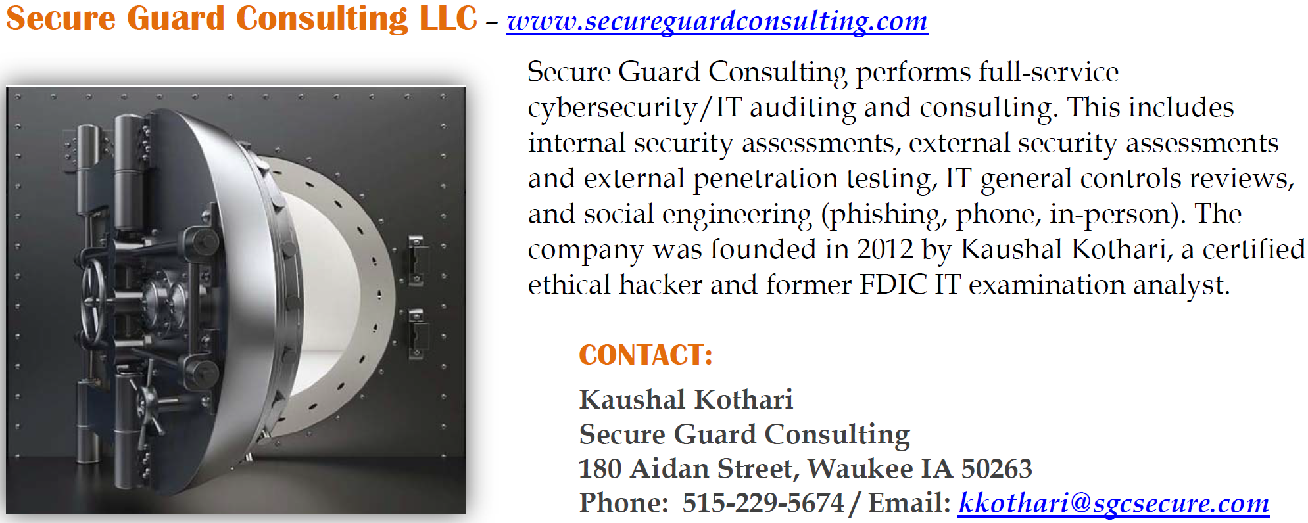
About Secure Guard Consulting

Slide 3
SGC Webinars
If interested – go out to our website, secureguardconsulting.com to look and see upcoming webinars.
These are all slated for an hour, but I will only go as long as needed to get information across.
Please let me know if there’s an additional topic any of you would like to see covered, and if interested, continue to check on our website as we post new webinars.

Slide 4
Today – AD Audit
A set of PowerShell scripts to perform some AD Audit functions.
Originally, we thought about running these as a separate audit, but realized quickly that this is really something that should be run more often than annually.
So, we’re releasing these for free.
Thank you to all of the banks that helped us with testing these scripts.

Slide 5
AD Audit
First time running this can be overwhelming.
  Brings in lots of information and accounts most banks don’t know are out there.
Common areas
  Mailbox accounts
  Service accounts
For everything identified that sticks around and isn’t disabled, we recommend populating the description field for the account, so every time you run this, the information is just there.
We recommend running this quarterly to stay on top of things.
NOTE: You will need admin, preferably domain admin capability to run these.

Slide 6
AD Audit Instructions

Slide 7
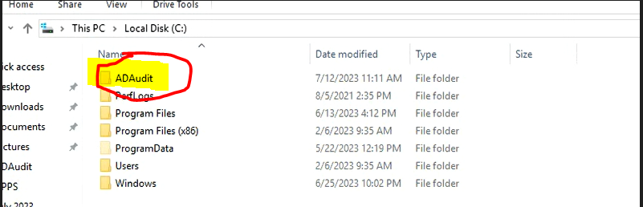
AD Audit Core
Set up a folder in your C: drive (on the domain controller) called ADAudit (not case sensitive, but why take a chance ☺)

Slide 8
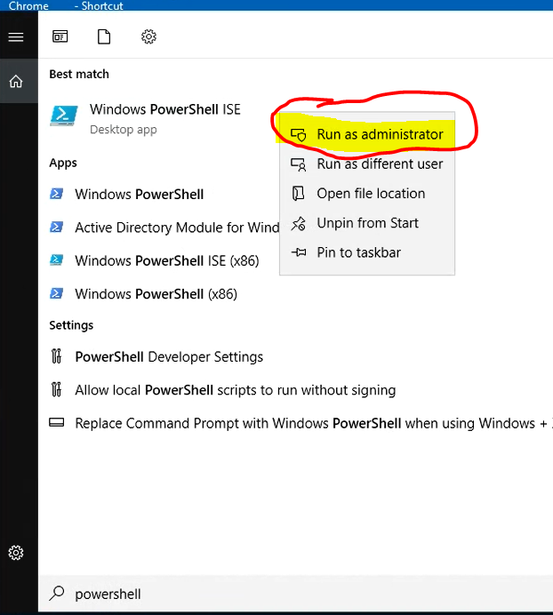
AD Audit Core
Search for PowerShell and run Windows PowerShell ISE
Right Click and Run as admin

Slide 9
AD Audit Core
Move the three text files with the PowerShell code to your Domain Controller, or in a folder you can access from the Domain Controller.
  ADAuditCore_v10.txt
  ADAuditMemberGroupsFinalNoBlankGroups_v8.txt
  ADAuditBlankGroupsFinal_v1.txt

Slide 10
AD Audit Core
Pull open code from “ADAuditCore_v10.txt”
  Select All
  Copy
Go to PowerShell and click in the window.
Right click and Paste (or ctrl-V)
Then hit Enter

Slide 11
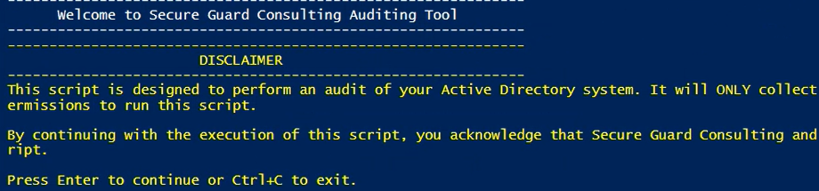
AD Audit Core
Disclaimer comes up. Click Enter to continue.

Slide 12
AD Audit Core
Prompt for either a custom path or the default path (C:\ADAudit).
  I suggest just creating the right folder in the C Drive and clicking Enter.

Slide 13

AD Audit Core
Once completed, you’ll see a screen like below

Slide 14
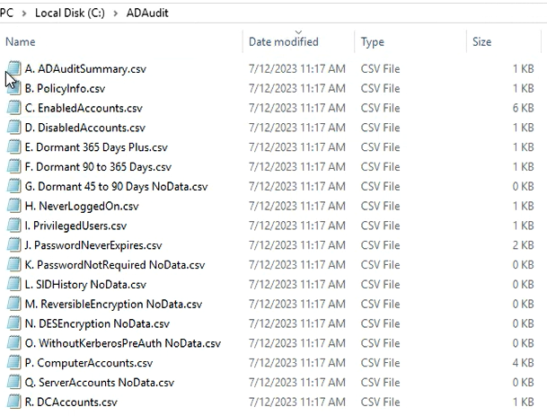

Slide 15
AD Audit Groups and Members
Now do the same thing with the other code in “ADAuditMemberGroupsFinalNoBlankGroups_v8.txt”
  Open the text document, select all, copy, go to PowerShell, paste, click Enter
  This second one there aren’t any prompts, it just runs.

Slide 16
AD Audit Groups and Members
Note: The script will error out on any groups that are set up as Foreign Security Principals (FSPs).
  When a group from a trusted, external domain or forest is added to a group in the local domain, an FSP object is created in the local domain to represent the external group. This allows the local domain to recognize and work with the group from the external domain.
Errors for FSPs will occur; these will be ignored; others will continue.
IIS_IUSRS Group is ignored by this script.

Slide 17
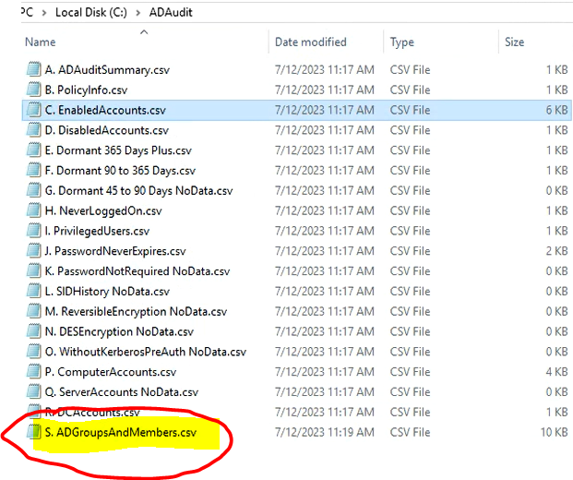

Slide 18
AD Audit Blank Groups
Now do the same thing again with the other code in “ADAuditBlankGroupsFinal_v1.txt”
  Open the text document, select all, copy, go to PowerShell, paste, click Enter
  This third one there aren’t any prompts, it just runs.
  Errors for FSPs will also occur here, but those with FSPs will just be ignored. Those without will continue.

Slide 19
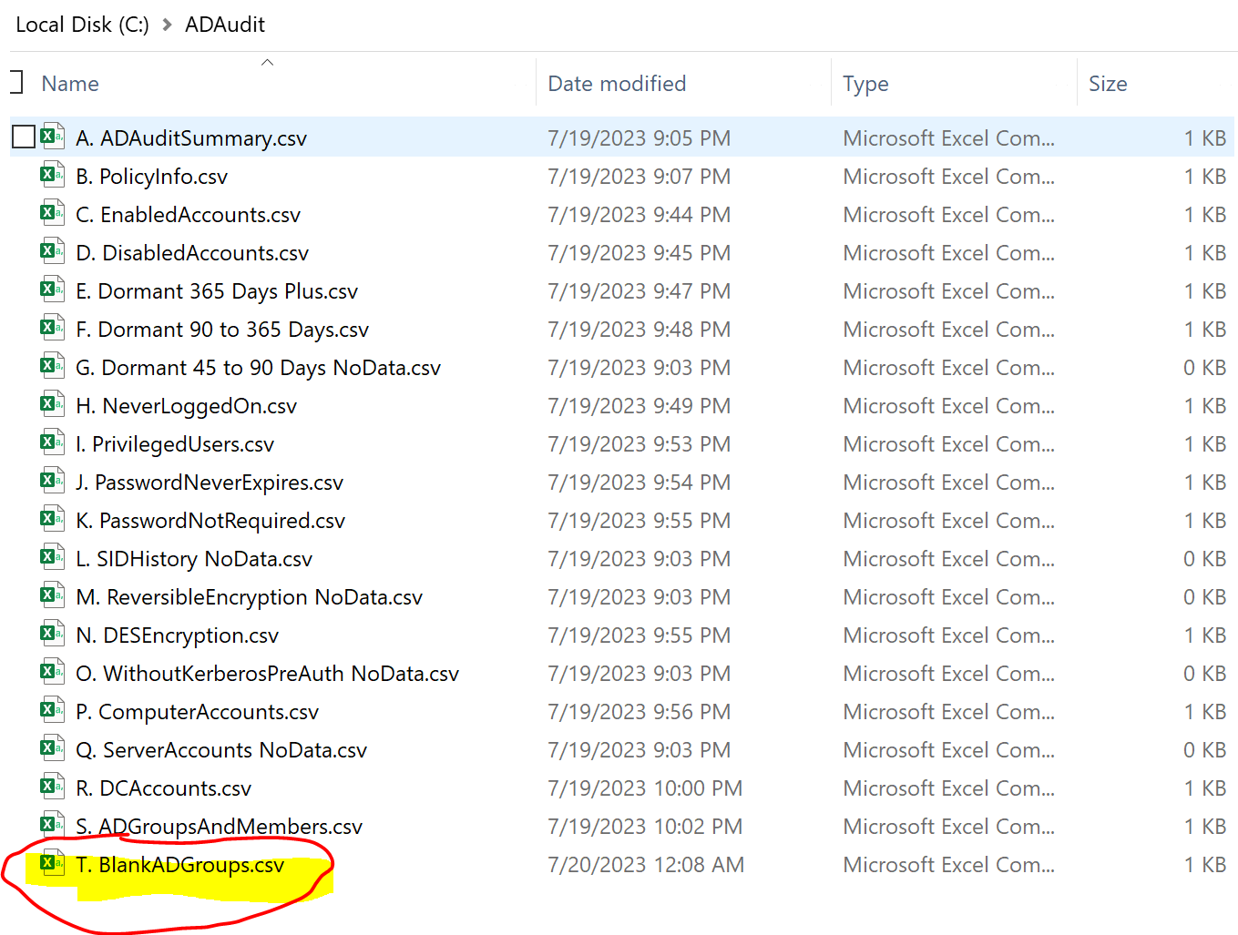

Slide 20
AD Audit Reference

Slide 21
AD Audit Reference
Total Users
Enabled Users
Disabled Users
Dormant accounts: Accounts that haven’t been logged into
  Between 45 and 90 days (CIS Controls driven)
  Between 90 and 365 days
  Greater than 365 days (Focus on this to start with!)

Slide 22
AD Audit Reference
Accounts that have Never Logged On
  Why do these accounts exist if they haven’t been used?
Privileged Users
Computer Accounts (this we just added for informational)
Server Accounts (same as Computer Accounts): Often times, servers are designated as Computer Accounts, so this may or may not be populated.
DC Accounts

Slide 23
AD Audit Reference
Accounts where the Password Never Expires.
  Generally, these will be service accounts.
  It’s important to know and make sure though.
Accounts with Password Not Required.
  Although a password may exist, a password should be required.

Slide 24
Accounts with SID History
The Security Identifier (SID) is a unique value that is used to identify an object, such as a user or a group, in the Windows security system.
Every object has a unique SID that is issued by Windows when the object is created, and this SID becomes part of the access token for that object.
  The access token, in turn, is used by Windows whenever that object (or a process running as that object) attempts to access a secured resource.
SID History is an attribute in Active Directory used to store former SIDs used by a user account. It comes into play when migrating accounts from one domain to another.
When you move a user account between domains (e.g., during domain consolidation or migration), a new SID is created for the user account in the new domain. To allow for seamless resource access, the old SID is added to the SID History attribute of the user account in the new domain.
This is useful because any permissions or rights that were assigned using the old SID will continue to work even after the account has been moved to the new domain. The Windows security subsystem checks both the account's current SID and the SIDs in the SID History attribute when determining the user's access rights.
While useful, the SID History attribute can also pose a security risk if not properly managed. Old SIDs can potentially be used to gain unauthorized access, so it's generally recommended to clear the SID History once the domain migration is complete and all resources have been properly re-permissioned using the new SIDs.

Slide 25
AD Audit Reference
Accounts with Reversible Encryption
  The option to store passwords using reversible encryption provides support for applications that require the user's password for authentication. Anyone who knows the account password can misuse the account. Microsoft recommends disabling this setting through Group Policy
Accounts with DES Encryption
  Accounts that can use DES to authenticate to services are at significantly greater risk of having that account's logon sequence decrypted and the account compromised, since DES is considered weaker cryptography.

Slide 26
AD Audit Reference
Accounts without Kerberos Pre Auth
  Kerberos preauthentication is a process where the client's identity is verified before any Kerberos tickets are issued.
  When the "Do not require Kerberos preauthentication" option is enabled for an account, it means this preauthentication step is skipped, and any client can request a Ticket Granting Ticket (TGT) for the user without needing to provide the proof of identity.
  users who have the "Do not require Kerberos preauthentication" option set (enabled)

Slide 27
AD Audit Reference
Account lockout threshold, password complexity enabled, lockout duration, password expiration, etc.
KRBTGT Account
  The KRBTGT account is a domain default account that acts as a service account for the KDC service. In most cases, KRBTGT resets might be performed when Active Directory is compromised. Still, Microsoft advises changing the password at regular intervals to keep the environment more secure.
  Either Disable or change password every 180 days.
    If changing password, needs to be changed twice in quick succession – make sure to consult your MSP for this.

Slide 28
AD Audit Reference
Tombstone Policy number of days
  The tombstone lifetime in Active Directory refers to the period of time that a deleted object (such as a user or computer account) is retained in the Active Directory database before it is permanently deleted. This period of time is also referred to as the deleted object's "tombstone lifetime."
  When an object is deleted from Active Directory, it isn't immediately removed from the database. Instead, most of the object's attributes are cleared out, and the object is marked as a "tombstone" and moved to a special container called the Deleted Objects container. The object will then remain in this state for the duration of the tombstone lifetime.
  If blank, defaults are used (60 or 180). Microsoft recommends 180 days. Check to make sure your default is 180 days, or set it to 180 days.

Slide 29
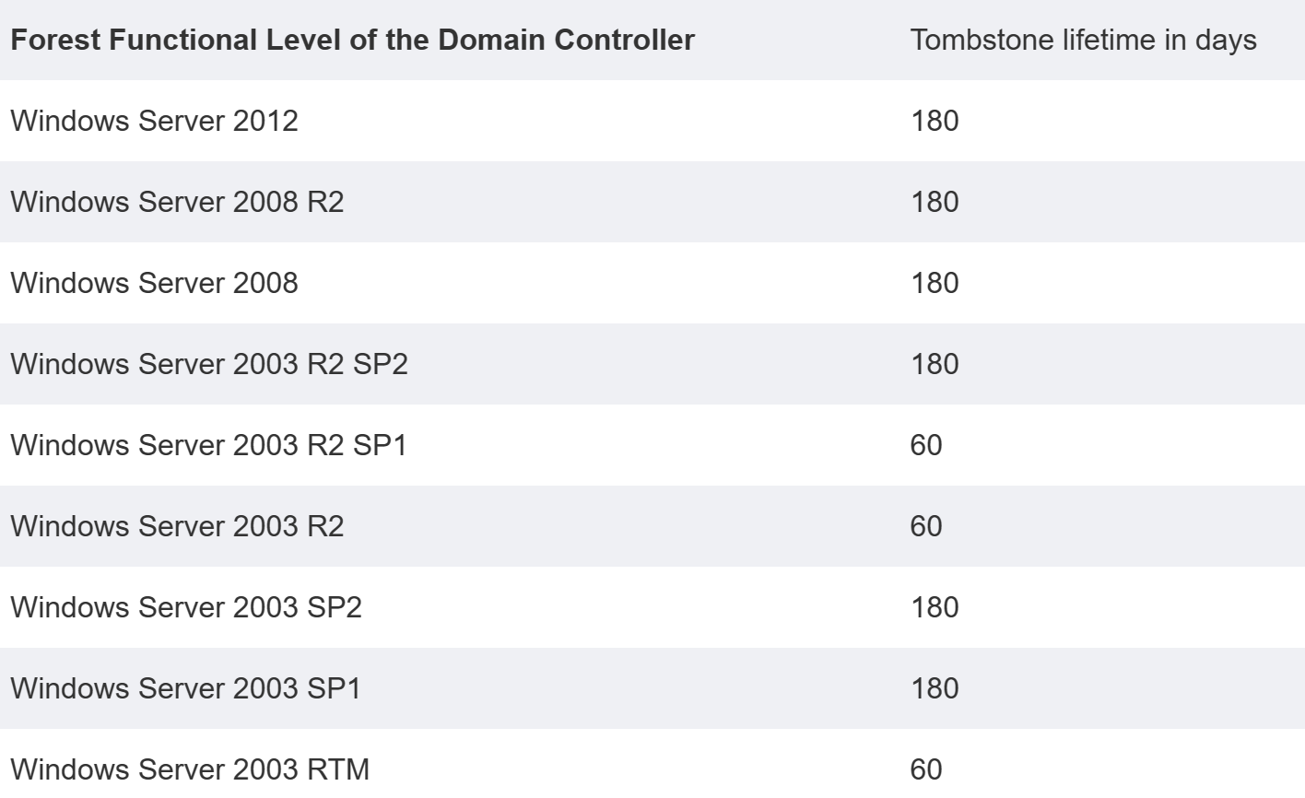
AD Audit Reference

Slide 30
AD Group Membership Audit Reference
AD Groups and Members – Internal AD Review
  Look through and make sure each group’s members should actually be members of each group.

Slide 31
AD Blank Group Audit Reference
AD Blank Groups (No Members) – Internal AD Review
  Look through and make sure each blank group to see whether it is needed any longer, especially since it doesn’t have any members.

